Slide 1
HL7 101 – A Simple Connected Patient and HL7 Demonstration

Slide 2
Agenda
Getting started with the HL7 Connector
Other Internal Resources
Simple Connected Patient Demo

Slide 3
What is HL7?
Health Level-7 or HL7 refers to a set of international standards for transfer of clinical and administrative data between software applications used by various healthcare providers. These standards focus on the application layer, which is "layer 7" in the OSI model.
ANSI X12 standard
V2 the most widely used healthcare data exchange format worldwide
It has an XML representation and wire format

Slide 4
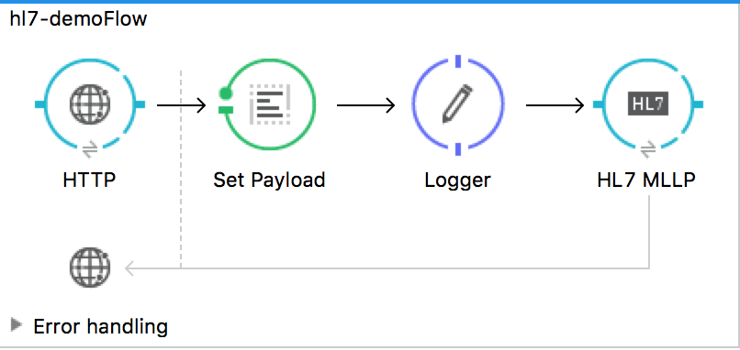
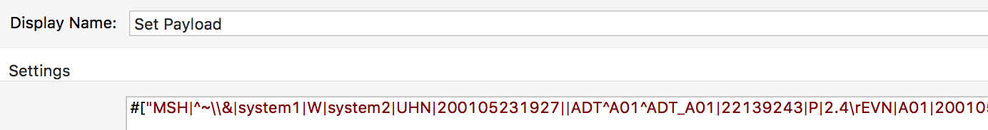
The HL7 Connector
I’ve installed it, made the demo in the docs work, now what?

Slide 5
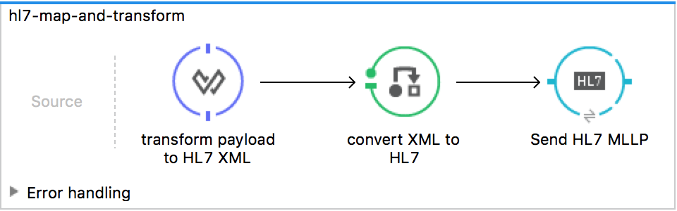
The HL7 Connector
Where are the HL7 XML schemas?
/AnypointStudio.app/Contents/Eclipse/plugins/org.mule.tooling.datamapper.hl7_*/hl7schemas/

Slide 6
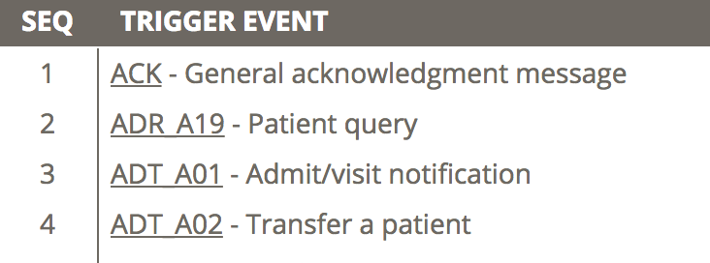

Understanding the HL7 Schema
Caristix
http://hl7-definition.caristix.com:9010/HL7%20v2.3.1/segment/Default.aspx?version=HL7+v2.3.1
…

Slide 7
Other Internal Resources
This demo is a 101 level - a simple HL7 demo and exploration of how to configure the HL7
Connector and understand the mapping. It is a starting point for more complex demos.
Fully realized healthcare demos can be found on the SC Portal:
- Re-tooled connected patient demo (Keith Sink)
https://scportal.bloomfire.com/posts/1316114
- Catalyst for Healthcare
https://scportal.bloomfire.com/posts/1339245

Slide 8
Healthcare HL7 101 Demo
Setup and script
See readme.md included in the project file

Slide 9
A Simple Connected Patient and HL7 Demonstration
(customer facing deck)

Slide 10
Agenda
MuleSoft In Healthcare
The MuleSoft HL7 Connector
Simple Connected Patient Demo

Slide 11

Digital Transformation Drivers in Healthcare
Legislative disruption: Reimbursement models, healthcare economics are changing
Increased competition: New market entrants threaten to displace incumbents
New care delivery models: Patient care increasingly occurs outside the clinic

Slide 12
Industry trends and impacts
Trend
Impact
Competition has increased across all healthcare market sectors: provider, payer, life sciences
Digital engagement has become increasingly important in acquiring and retaining customers
The increase in EHR usage, and the proliferation of medical devices and mobile apps has contributed to an explosion of medical data
To capitalize on the power of this data, healthcare IT teams need the ability to connect clinical and non-clinical systems
Healthcare reimbursement is transitioning from a “fee-for-service” model to one based on “value” or outcomes
Under a “value-based” paradigm, health IT teams are increasingly asked to support projects that improve clinical outcomes

Slide 13
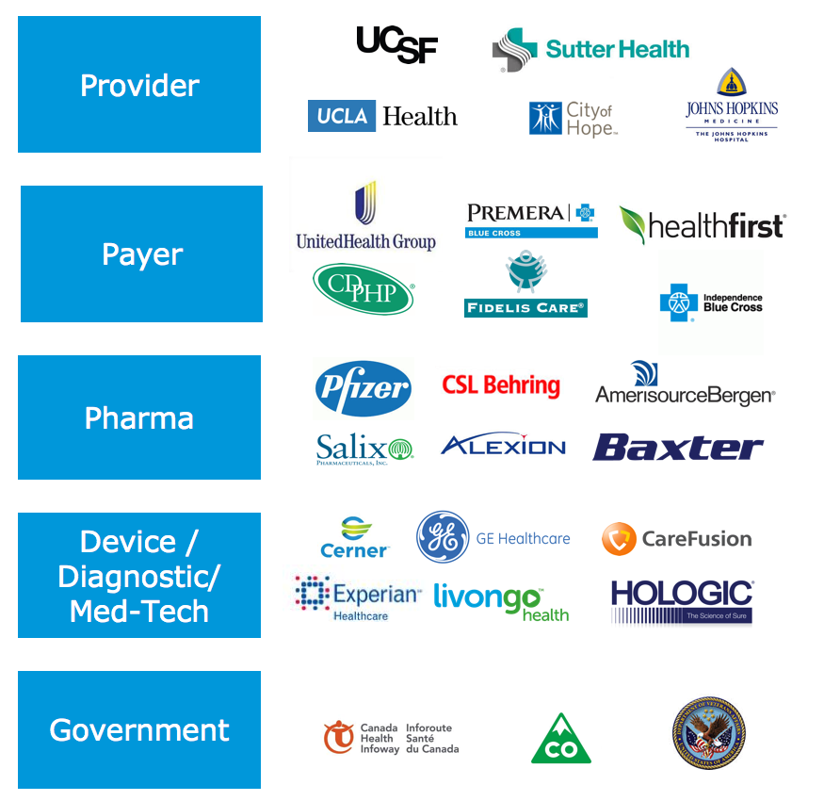
Digital transformation in healthcare
From “Why” to “How”
Best practices from MuleSoft healthcare customers
Digital Transformation Success Stories
Expose, manage, and govern data with APIs.
Leverage MuleSoft HL7 connectivity to integrate between clinical and non-clinical systems.
Employ an API-led architecture to increase project delivery speed through asset self-service and reuse.
Notes:
Digital transformation imperative is clearly understood. The question is “how?”
Over the past 5 years, we’ve worked with many of the largest and most progressive organizations across providers, payers, and life sciences to help drive digital transformation with our Anypoint platform.
This experience has given us a unique vantage point into the connectivty challenges facing healthcare IT teams, and helped us develop a set of “best practices” for driving digital transformation in healthcare.
Exposing data through APIs. As the world moves towards the FHIR standard, APIs have rightfully taken center stage as a core component toward enabling digital transformation in healthcare.
However, APIs ON THEIR OWN are insufficient to drive transformation in healthcare. Getting the right data into those APIs requires data transformation, between HL7 and JSON or other data patterns, in order to connect between clinical systems like EHRs, and non-clinical systems like Salesforce Health Cloud, Trizetto Facets, or other key systems of record in healthcare. One of the primary reasons that so many healthcare organizations have chosen MuleSoft to serve as the heart and lungs of their digital transformation efforts is because we support API management and HL7 integration on a single platform, on the same run-time.
Lastly, we’ve found that the architecture really matters. OUr most successful customers in healthcare have employed an API-led connectivity approach to architecture, which has allowed them to increase project delivery speed by building and leveraging self-service, reusable artifacts on the system, process, and experience level.

Slide 14
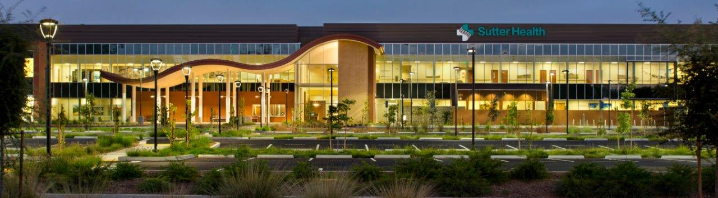

Accelerating development by 66% through IT as a Service
“MuleSoft powers our innovation vision. We chose to partner with them to drive speed of execution”
Kristen Wilson-Jones, CTO RD&D
CTO-led transformation to respond to increasing pressure for faster delivery
Increase organizational agility by building composite services through an API led strategy
IT as a Service allowing LoBs to self-serve via highly accessible APIs and connectivity
Notes:
Industry: Healthcare and Life Sciences
Segment: Healthcare Provider
About Sutter Health
Sutter Health is a not-for-profit health system serving more than 100 communities in Northern California; each year its 5,000 physicians care for more than 10 million outpatient visits and discharge more than 200,000 in-patients. Sutter Health was recently named by Truven Analytics as one of the top-20 health care systems for quality in the United States.
Background
Sutter Health’s Central IT was under increasing pressure from line of business teams to be more responsive and deliver applications more quickly.
Challenges
Increasing pressure from line of business teams for Central IT to be more responsive and deliver applications more quickly
Duplication of effort across multiple application development initiatives
IT unable to meet the pace of change required in the ‘new normal’ competitive paradigm
Solution
Sutter selected MuleSoft’s Anypoint to power Project Maestro, a platform of reusable microservices, exposing data from Epic, HIE, case management and call center applications, that is leveraged across multiple population health management and patient engagement applications.
Leverage APIs to ‘unbundle’ data assets and services into a series of re-usable building blocks that can be leveraged by multiple stakeholders
e.g. Built a composite Patient Demographics API that exposes a single patient data object that a/ is sourced from multiple system and b/ can be accessed by multiple downstream applications
Drive greater organizational agility and decreased operational cost by driving re-use of APIs and drive a developer first strategy that increases focus on business outcomes and abstracts away non value added work
Results
66% shorter application development cycles: applications that would typically have taken 9 months to develop, now delivered in 3.
Quote
“MuleSoft powers our innovation vision. We chose to partner with them to drive speed of execution”, Kristen Wilson-Jones, CTO RD&D, Sutter Health
Supporting Assets
Customer webinar: Sutter Health: Leveraging Predictive Analytics to Lower 30-Day Readmit Rates (Link)
Customer webinar slides: Sutter Health: Leveraging Predictive Analytics to Lower 30-Day Readmit Rates (Link)
Customer video: YouTube (Link)

Slide 15
Anypoint™ Connector for HL7
facilitates integration with healthcare systems by providing the tools needed to easily create, read and transform HL7 version v2.x messages
HL7 ER7 message-reading, message-validation, and message-writing
HL7 message packs for v2.1, v2.2, v2.3.1, v2.3, v2.4, v2.5, v2.5.1, v2.6, 2.7, 2.7.1, 2.8, and 2.8.1
The ability to define your own schemas or customize the base HL7 schemas

Slide 16
Demo Architecture
Populate DB API
Patients API
Visits and Lab API
HL7 MLLP
Database Connector
Database Connector
Database Connector
JDBC
JDBC
JDBC
Patients System
Visits System
Lab System

